Slide 1

NovaCare Insurance
Claims Denial Crisis
A Strategic Review for the Chief Financial Officer
$18M
39.58%
$7.22M
$2.46M
Total Billed
Denial Rate
Revenue Leakage
Recoverable Now
April 2026 | Based on full claims dataset analysis

Slide 2
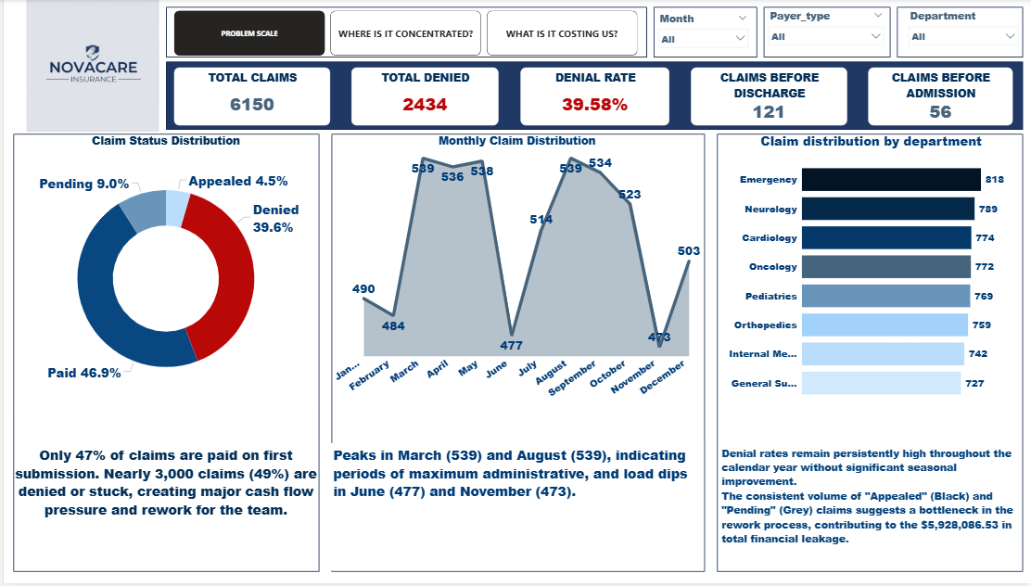
PAGE 1 — WHAT IS THE SCALE OF THE PROBLEM?

Slide 3
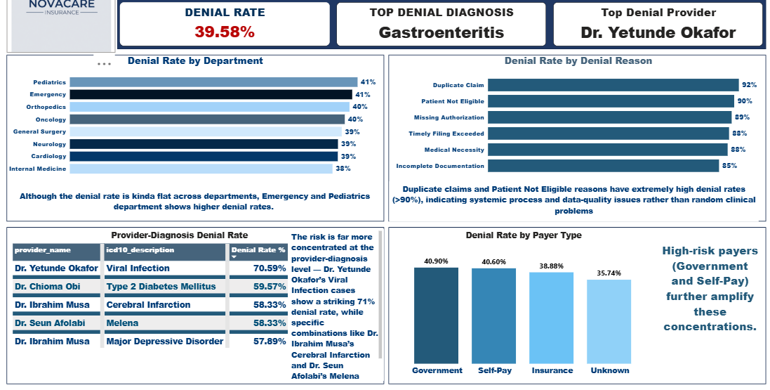
PAGE 2 — WHERE IS THE PROBLEM CONCENTRATED?
Key Concentration Findings
Top provider: Dr. Yetunde Okafor — Viral Infection cases hit 71% denial rate Top diagnosis: Gastroenteritis drives highest volume of denials Duplicate & Eligibility denial rates exceed 90% — pure process failures

Slide 4
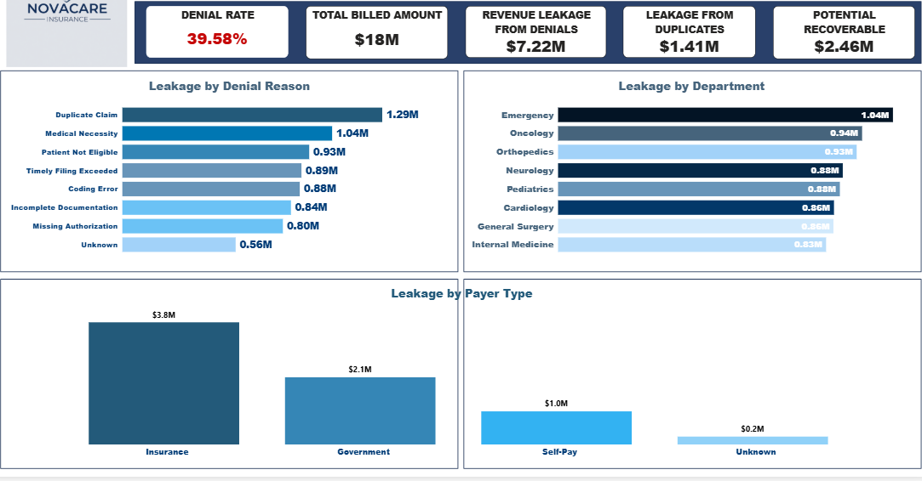
PAGE 3 — WHAT IS IT COSTING US?
40% of billed revenue is leaking. Duplicate Claim errors alone account for $1.4M. The $2.46M in Pending + Appealed claims is recoverable if actioned within 30 days.

Slide 5
THE TOP 3 DENIAL DRIVERS
01
Duplicate Claims
91.88% Denial Rate | $1.4M Leakage
480 duplicate claims were filed — the single largest source of preventable denials. With a 91.88% denial rate, almost every duplicate is rejected, yet they keep being submitted. This points to a broken claims intake process, not a clinical problem.
02
Patient Eligibility Failures
90.17% Denial Rate | $0.9M Leakage
Patient eligibility is not being verified before services are rendered or claims are filed. A 90% denial rate means staff are submitting claims for patients whose coverage is already lapsed or out-of-network — a fixable process gap.
03
Missing Authorization & Timely Filing
89.24% + 88.29% Denial Rates | $1.7M Combined
Pre-authorization is not being obtained before high-cost services, and completed claims are not being filed within payer deadlines. Both are entirely preventable with workflow controls and staff training.

Slide 6
3 SPECIFIC RECOMMENDATIONS FOR THE CFO
R1
Deploy a Real-Time Duplicate Detection System
Potential Recovery: $1.4M
480 duplicate claims represent the single most actionable fix. Implementing a pre-submission duplicate check — comparing claim ID, patient ID, date of service, and procedure code — would eliminate this at source. Industry-standard claims management systems (e.g. Availity, Waystar) provide this natively. Target: zero duplicate submissions within 60 days.
R2
Mandate Eligibility Verification Before Every Service
Potential Recovery: $0.9M
Patient eligibility checks must occur at the point of scheduling, not at the point of billing. A 90.17% denial rate on eligibility means patients are being seen whose coverage is already invalid. Integrate real-time eligibility verification (REV) into the registration workflow. This is a 30-day operational fix that requires no new technology — most EHR systems have this capability unused.
R3
Act on the $2.46M in Pending & Appealed Claims Now
Recoverable: $2.46M within 30 days
There is $2.46M sitting in Pending and Appealed status today. These claims have already been filed — the only thing standing between NovaCare and this revenue is follow-through. Assign a dedicated team to work this queue within 30 days before payer deadlines extinguish recovery rights. Prioritize Pediatrics and Emergency departments which show the highest denial rates (41.45% and 40.71%).

Slide 7
WHAT WE WOULD INVESTIGATE NEXT
Dr. Yetunde Okafor — 71% Denial Rate on Viral Infection
177 Date Errors — Are They Systemic?
This is a statistical outlier. A 71% denial rate on a single provider-diagnosis combination warrants a clinical and billing audit. Is this a coding issue, a medical necessity documentation gap, or a payer-specific pattern? A focused review of 30 claims could answer this within two weeks.
177 claims contain date errors. This volume is too large to be random human error. We need to trace whether these originate from a specific EHR module, department, or registration staff cohort. If a single system misconfiguration is creating date errors at scale, one IT fix closes all 177.
Government & Self-Pay Payer Mix (40.9% Denial Rate)
Pediatrics Department — Highest Departmental Denial Rate
Government payers (40.9%) and Self-Pay patients (40.6%) carry the highest denial rates. The Self-Pay cohort in particular may include patients who were never adequately screened for coverage eligibility or charity care programs. A deeper payer-mix analysis could reveal whether NovaCare is systematically leaving safety-net revenue uncollected.
Pediatrics leads all departments at 41.45% — higher than even Emergency. This is unusual because pediatric billing is typically predictable. We want to understand whether this is driven by guardian eligibility lapses, referral authorization gaps, or a particular diagnosis cluster. Isolating the top 5 denial reasons in Pediatrics alone could unlock $0.3–0.5M in recovery.
NovaCare Insurance | Claims Analysis — CFO Briefing | April 2026 | CONFIDENTIAL

Slide 8
APPENDIX — AT A GLANCE SUMMARY TABLE
Metric | Value | Benchmark / Context | Status
Total Claims Filed | 6,150 | Industry varies | Baseline
Overall Denial Rate | 39.58% | Industry avg: 5–10% | CRITICAL
Total Revenue Billed | $18M | — | —
Revenue Lost to Denials | $7.22M | 40% leakage rate | CRITICAL
Leakage from Duplicates | $1.4M | Should be $0 | ACTION NEEDED
Recoverable (Pending+Appealed) | $2.46M | Time-sensitive | ACT NOW
Top Denial Reason Rate | 91.88% (Duplicates) | Should be <5% | CRITICAL
Top Provider Denial Rate | 71% — Dr. Yetunde Okafor | Flag for audit | INVESTIGATE
Top Department | Pediatrics 41.45% | Unexpectedly high | INVESTIGATE
Date Errors | 177 claims | Likely systemic | ACTION NEEDED
Duplicate Claims Filed | 480 | Should be 0 | FIX IMMEDIATELY

